Slide 1
Remote Job Market During COVID-19 February 2021
Ibrahim Awad
NYC Data Science Academy

Slide 2
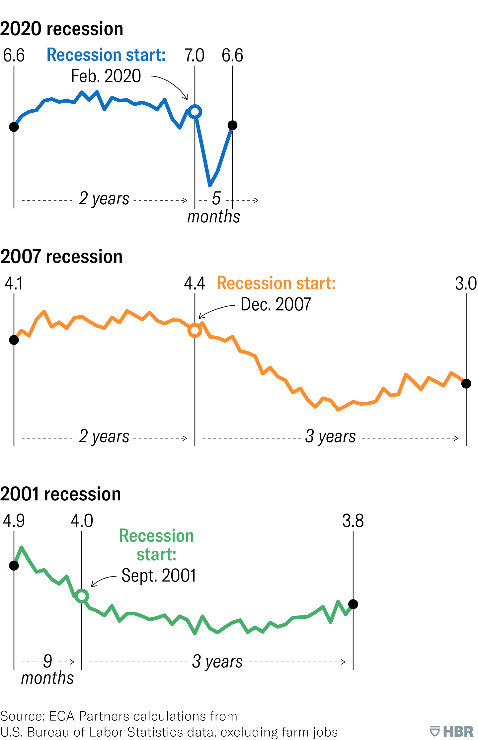
Motivation
Total job openings per month in millions
Because working from home is more common at this time, I have focused my investigation on the remote job market.
This analysis can benefit staffing companies as well as job applicants.
U.S. job openings during past recessions show a common pattern:
according to Harvard Business Review,* the job market is going through structural change
high rates of jobs disappear and reappear within the same time-frame
in 2020, the number of job openings fell then rose quickly
* https://hbr.org/2020/10/why-hiring-during-covid-is-different-than-in-previous-downturns

Slide 3
Objectives
Where are the companies that require remote employees located?
What are the posting rates for remote positions by companies from these locations?
What are the most requested job types for remote positions?
What are the most requested qualifications for remote positions?
How are the salaries distributed?
What are the characteristics of lower- and higher-paying jobs?

Slide 4
Datasets
Data was collected by scraping Indeed.com for remote jobs by Scrapy
Total number of scraped jobs, after filtering duplications:
5,372 jobs
Duplicated job postings were made almost entirely by staffing companies (~3,400 jobs)
Postings were collected from the top 5 posting locations:
NYC, Chicago, Atlanta, Los Angeles, and
Washington, DC
The majority of postings have "unspecified" listed for location

Slide 5
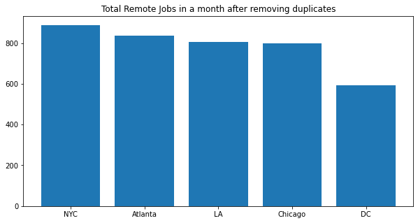
Where are the companies requiring remote employees located?

Slide 6
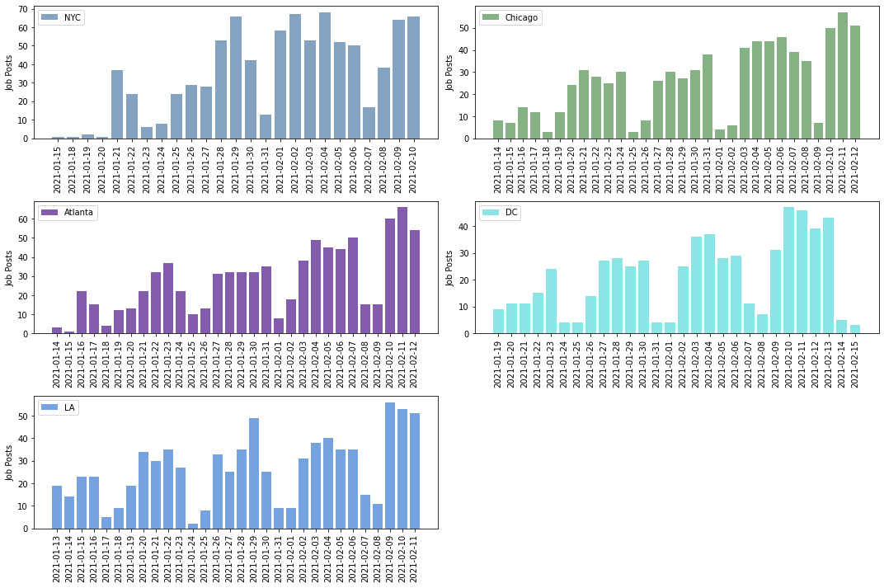
What are the posting rates by companies for remote positions from these locations?

Slide 7
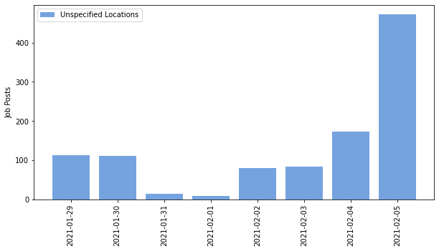
What are the posting rates by companies for remote positions from these locations?
Most of the jobs have unspecified locations
About 1,400 jobs in just 7 days
Errors due to duplications may have occurred
3,326 duplicated jobs (mostly by staffing companies)

Slide 8
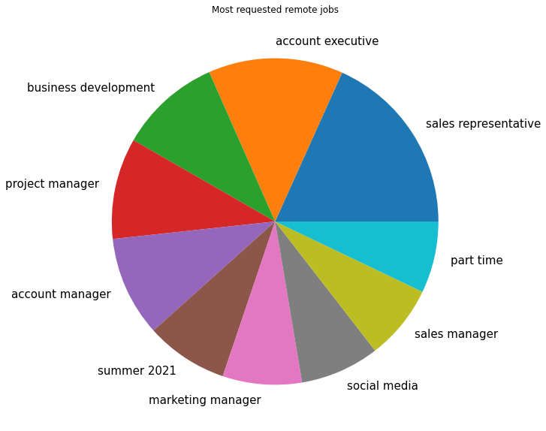
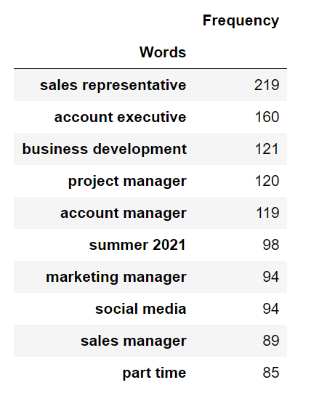
What are the most requested job types for remote positions?

Slide 9
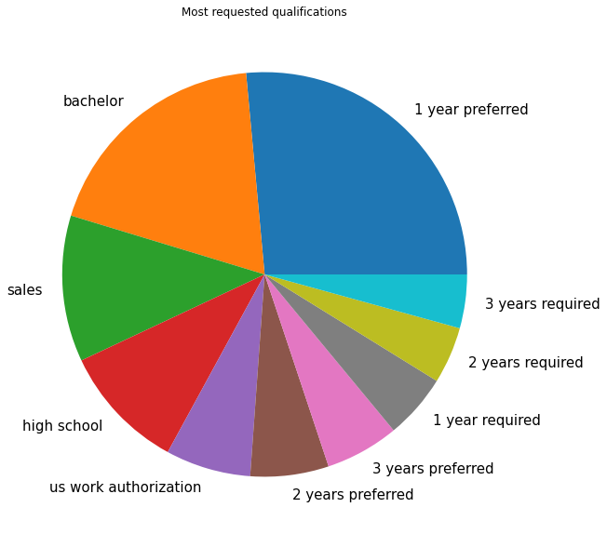
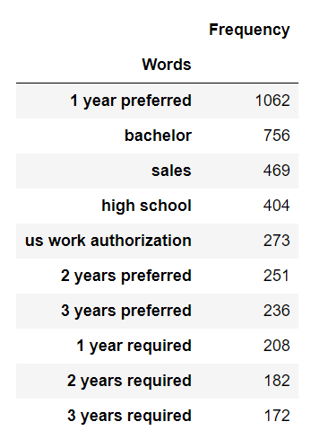
What are the most requested qualifications for remote positions?

Slide 10
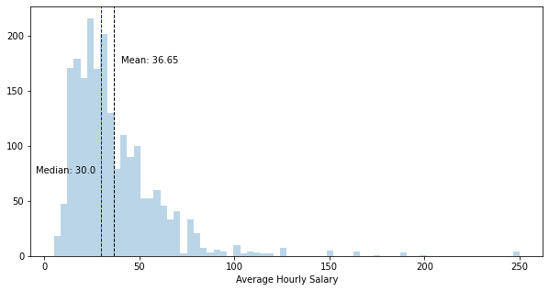
How are the salaries distributed for remote positions?
2,053 job postings have salaries (961 below median and 1092 above median)

Slide 11
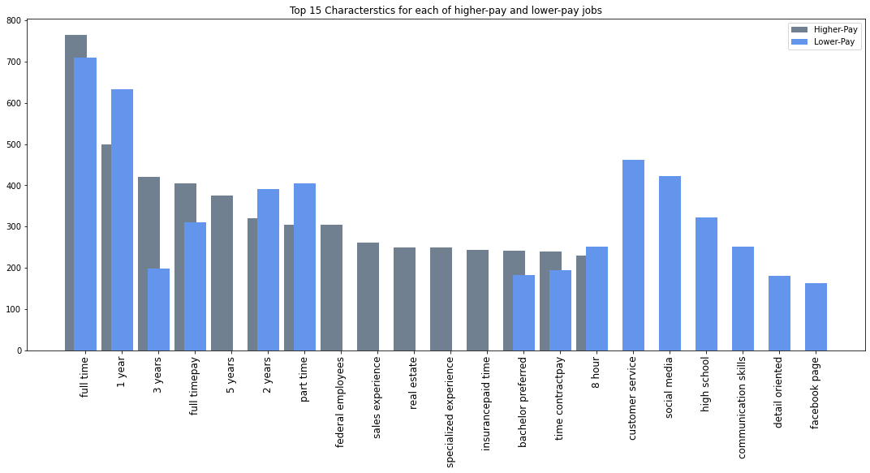
What are the characteristics of lower- and higher-paying jobs? (from scraped job descriptions)

Slide 12
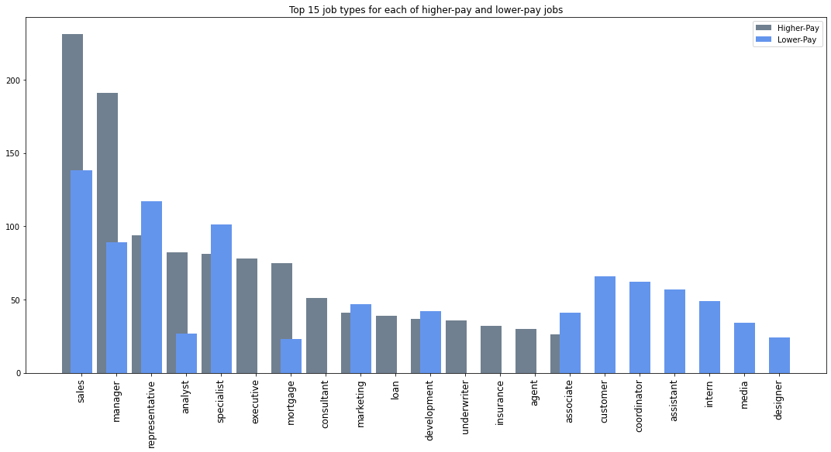
What are the characteristics of lower- and higher-paying jobs? (from scraped job titles)

Slide 13
Conclusions
Staffing companies invest a lot on indeed.com. Duplicates accounted for ~70% of the scraped data.
The top postings are from these locations are in this order: NYC, Chicago, Atlanta, Los Angeles, and Washington, DC.
Middle of the week is when most of the jobs are posted.
The majority of the posted remote jobs don’t have a specified location.
Most of the posted jobs are sales, marketing and business development jobs.
Most of the required qualifications are 1 year experience and bachelor.
The median estimated salary for the remote jobs is $60,000 a year.
More salaries are offered to federal employees, candidates with sales experience, real estate experience and above 2 years experience.
Less salaries are offered to customer service, representatives, specialist, social media and part-time jobs.

